Slide 1

Phase 9: Reporting Dasboards & Security Review
Phase 9 focused on transforming raw data into actionable business intelligence and securing the application. This involved creating a custom report type, building three key reports, consolidating them into a dynamic dashboard, and implementing critical security controls for users and the organisation.

Slide 2
Custom Report Type Creation
To analyse data across Clients and Appointments, a custom report type was created.
Name
Primary Object
Related Object
Clients with Appointments
Contact (Client)
Appointments
Relationship: Each Contact record must have at least one related Appointment record.

Slide 3
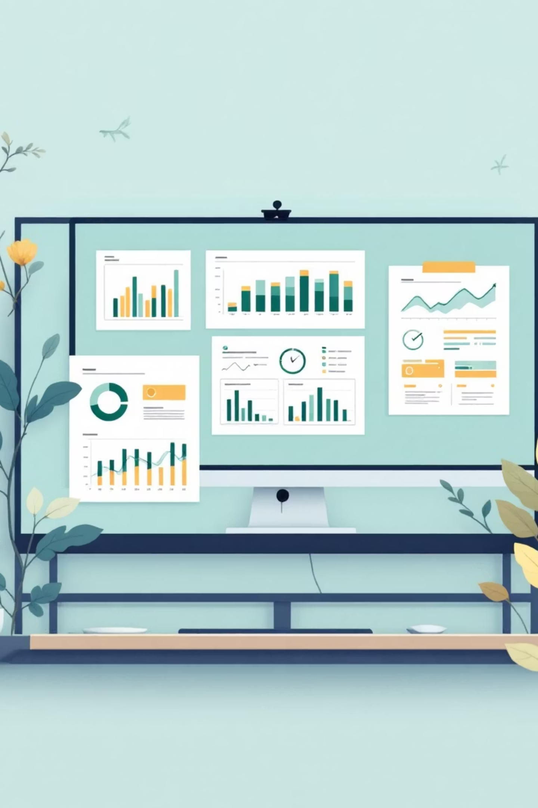
Report Creation Overview
All reports were saved in a new folder named "Salon Reports".
1
Today's Appointments List
Tabular report showing daily appointments
2
Appointments by Stylist This Week
Summary report with bar chart visualisation
3
Weekly Revenue by Service
Matrix report showing revenue breakdown

Slide 4
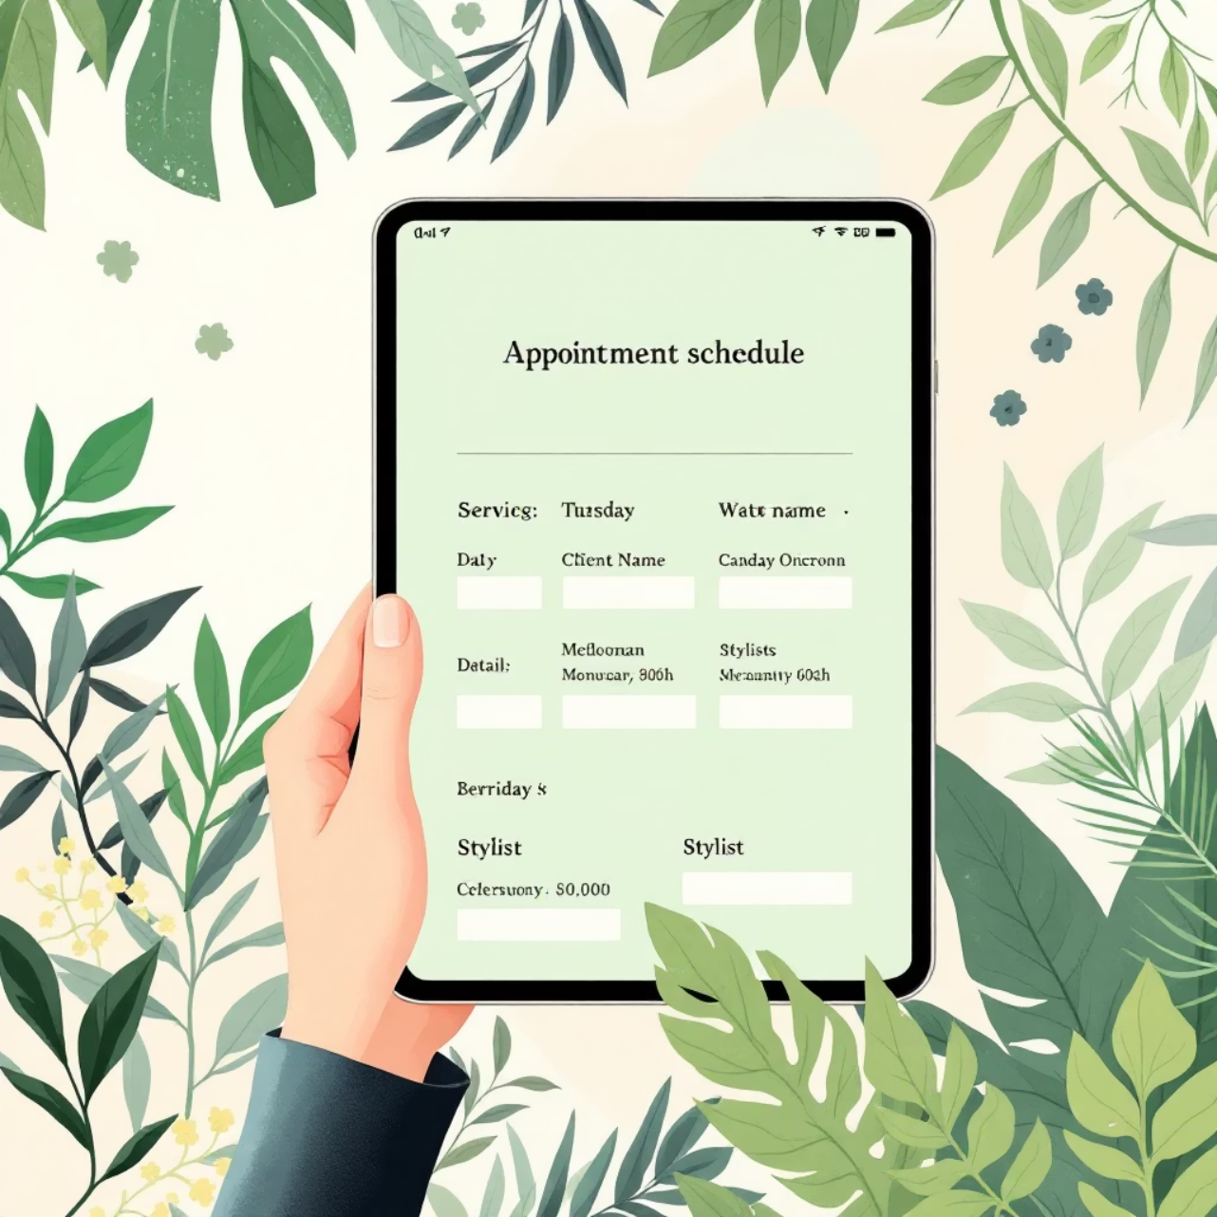
Report A: Today's Appointments List
Configuration Details
Type: Tabular
Report Type Used: Clients with Appointments
Key Columns: Full Name, Service: Service Name, Stylist: Name
Filter: Appointment Date & Time equals TODAY

Slide 5
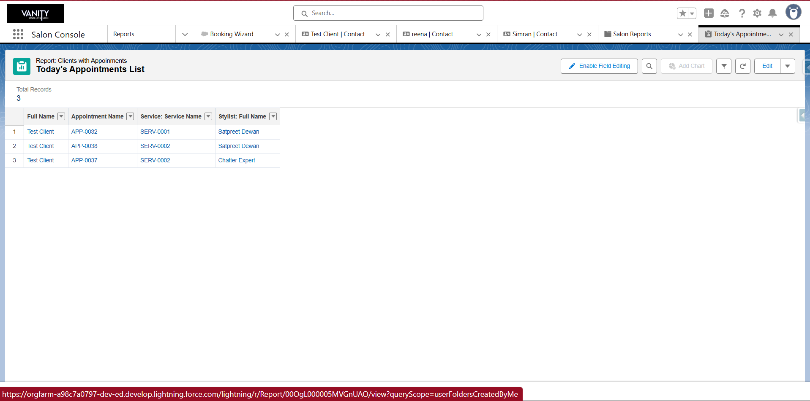

Slide 6
Report B: Appointments by Stylist This Week
Type
Report Type Used
Summary
Clients with Appointments
Group By
Filter
Stylist: Name
Appointment Date & Time equals This Week
Visualisation: A Bar Chart was added to visually compare stylist performance.

Slide 7
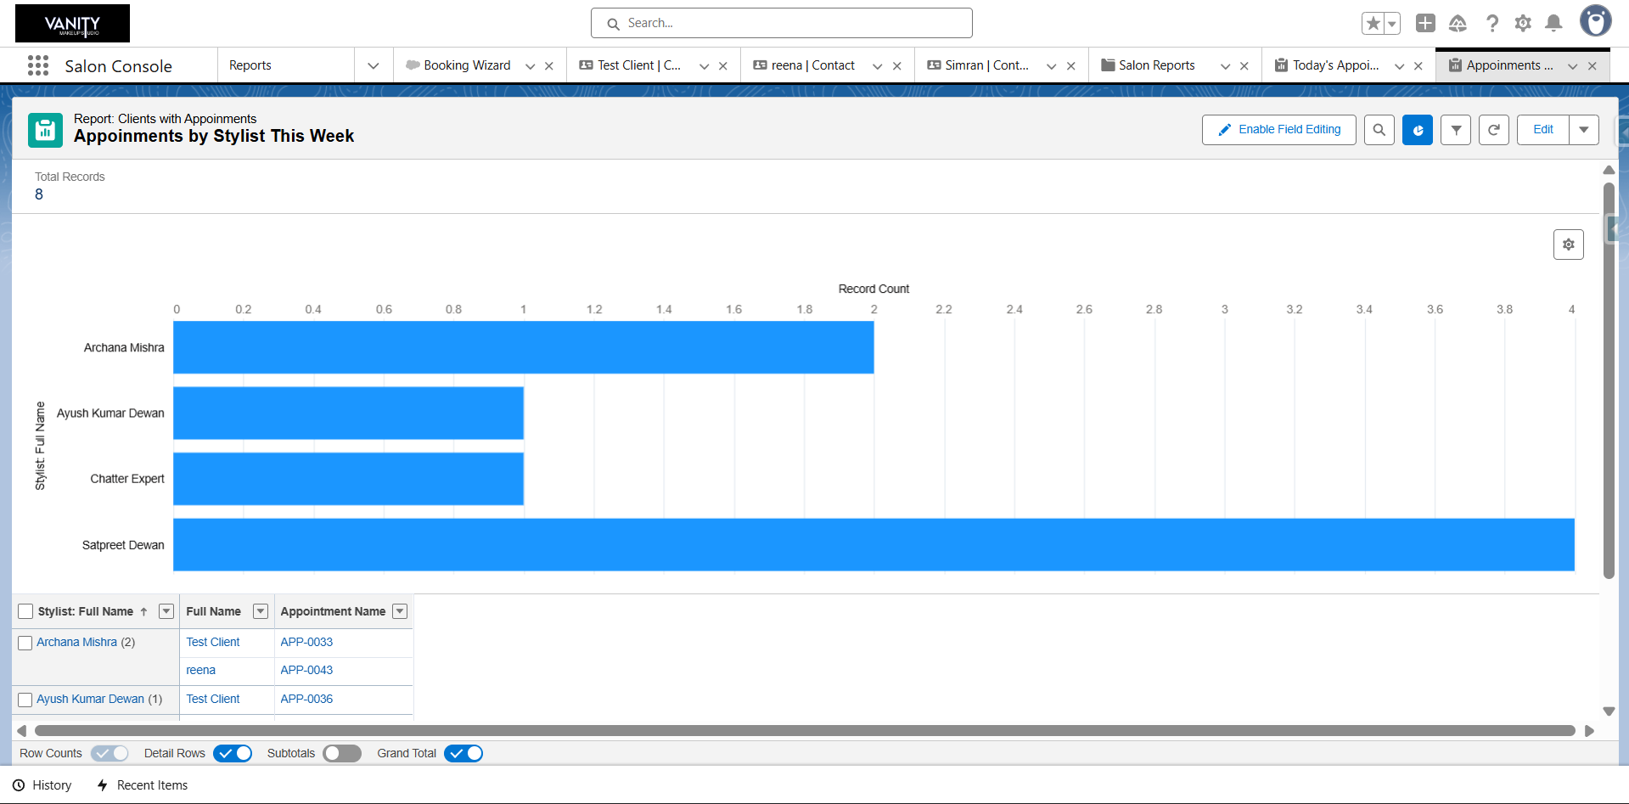

Slide 8
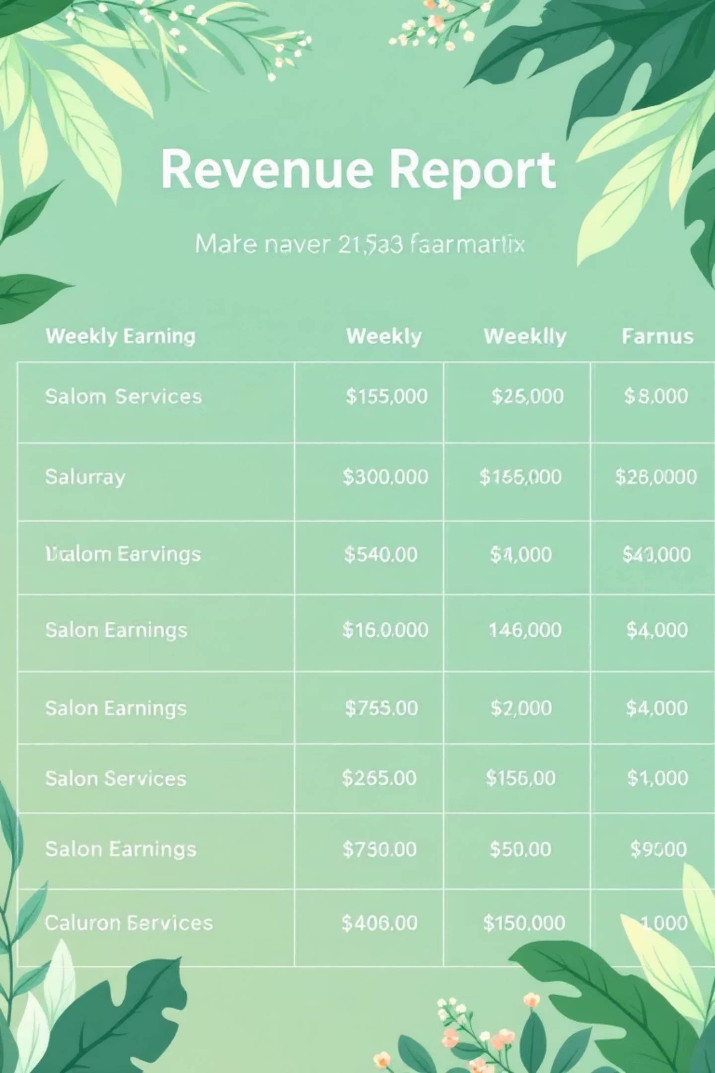
Report C: Weekly Revenue by Service
Configuration
Structure
Type: Matrix
Column Grouping: Appointment Date & Time (Grouped by Calendar Week)
Report Type Used: Clients with Appointments
Row Grouping: Service: Service Name
Summarised Field: The Price field was summarised by Sum

Slide 9
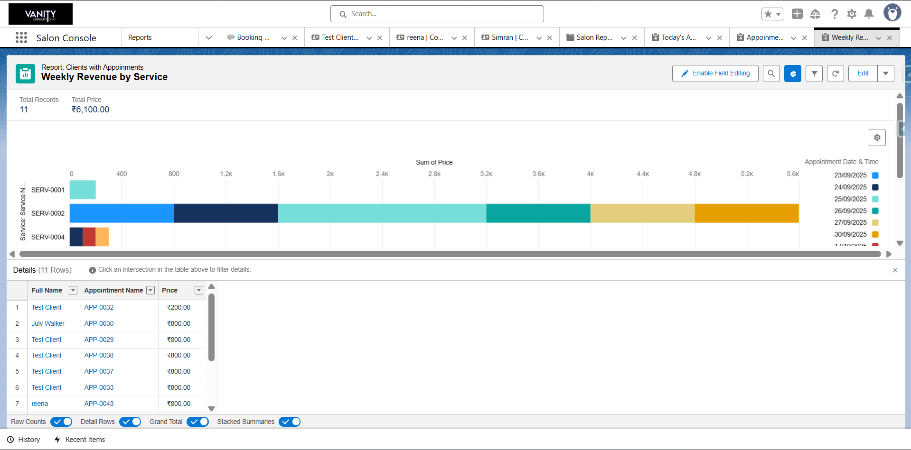

Slide 10
Dashboard Configuration
A central dashboard was created to provide a command centre view of the salon's performance.
01
02
03
Dashboard Creation
Components Added
Layout Arrangement
Name: Salon Performance DashboardFolder: Saved in a new folder named Salon Dashboards
Appointments by Stylist This Week (Displayed as a Bar Chart)Weekly Revenue by Service (Displayed as a Chart)Today's Appointments List (Displayed as a Lightning Table)
The components were arranged on the canvas for optimal viewing

Slide 11
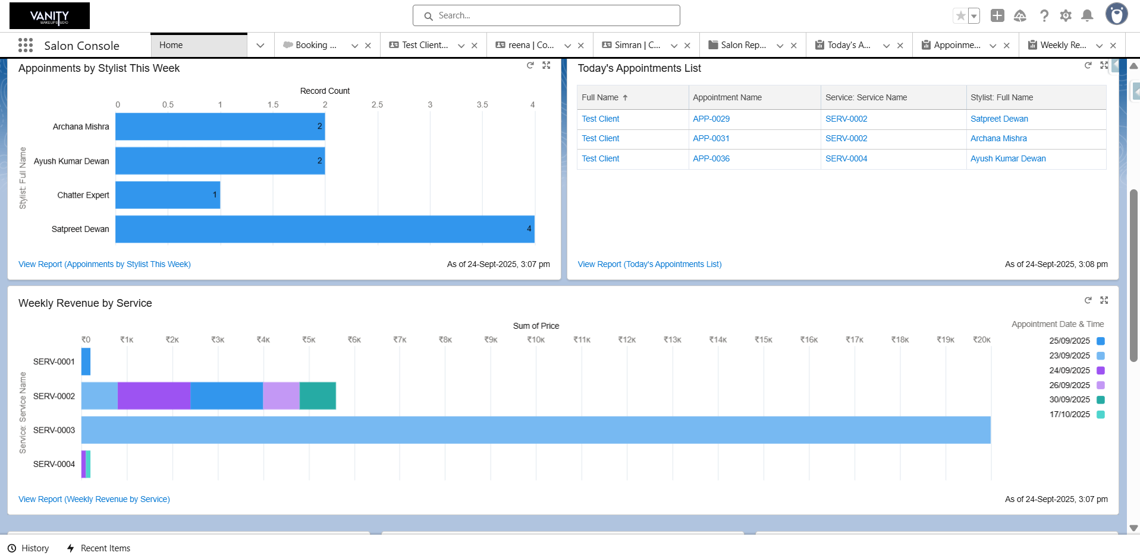

Slide 12
Security Review: Time Zone & Field Level Security
Time Zone Configuration
Field Level Security (FLS)
Org-Wide Default: Set to (GMT+05:30) India Standard Time
Objective: Prevent stylists from changing the price of a service
Personal User Setting: Verified and set to the same India Standard Time
Action: The Stylist profile's access to the Price field on the Appointment object was modified to be Read-Only

Slide 13
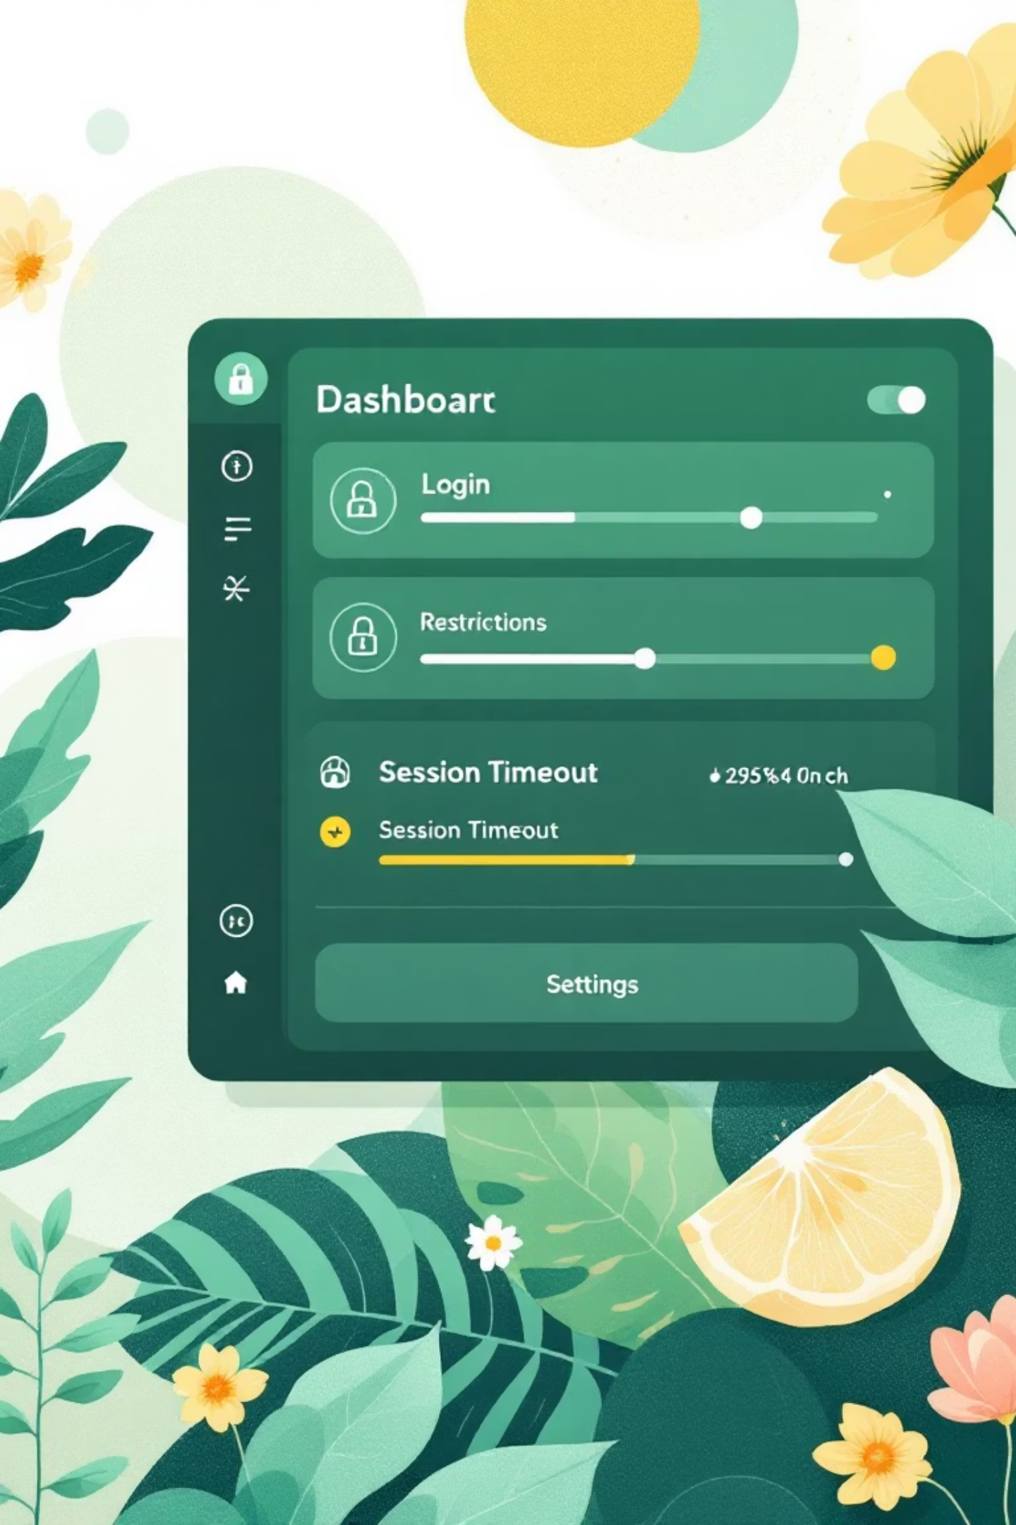
Security Review: Login Controls & Session Settings
Login IP Ranges
Objective: Restrict where the receptionist can log in from for enhanced security
Action: A Login IP Range was added to the Receptionist profile, restricting access to the salon's specific IP address
Session Settings Review
Action: The Session Timeout value was reviewed
Recommendation: For a public-facing computer like a reception desk, the default timeout of 2 hours was updated to a more secure duration like 1 Hour or 30 Minutes

Slide 14
